Slide 1
LatentView Data Engineering proposal for United Airlines
Dec 2018

Slide 2
Agenda
1
About LatentView
2
LatentView and United Engagement summary
3
LatentView’s POV on Data Migration
4
Enabling Data as a Service

Slide 3

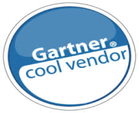
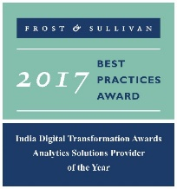




Trusted Analytics Partner to the World's Most Recognizable Brands
Awards & Recognition
Founded in
Over
Grown
Work with
Strong Performer - Customer Analytics Services, 2017
600
11
30+
2006
People strong
times in last
six years
Fortune 500
firms
Repeat business at
Member of
2009-2017
Technology council
Only company recognized
9
5%
4/5
>85%
Repeat
business at
consecutive times in Deloitte Technology Fast50
Re-investment in Research and Development
Top technology companies engage with us

Slide 4
Engagement with United
Project Streams
Digital Test Lab
Contact Optimization & Customer Signal Hub
Loyalty Redemption Analysis
Daniel Mack
Reed Knox
Mehul Patel
Building Spotfire dashboards for dTL tests.
Performing adhoc analysis as per requirement
Developing a propensity model to identify the probability of each customer to open a specific email
Building audience sizing tool using Spotfire for product and marketing managers
Maintaining 5 Loyalty metric dashboards
FIFO Analysis - Understand customer air redemption pattern across various products like Buy Miles, Give Miles, Transfer Miles, Marriott Rewards, Ultimate Rewards, Perks Plus using First in first Out (FIFO) logic

Slide 5
LatentView’s POV on Data Migration

Slide 6
Data migration process
United Airlines is migrating to Palantir Foundry platform for Data Integration & CoE
Data as a service
Data Migration
Monitoring & Maintenance
Data democratization
Framework for data science
1
2
3
4
Moving data from existing data sources to foundry
Creating data pipeline for future updates
ETL management
Integration of new data sources
Access management & decentralization of data platform
Custom build UI/apps for reporting & insight generation
New features development enabling data pull for adhoc analysis in a governed environment
Framework for modelling using technologies like datarobot, H2O etc.
Integration with other cloud technologies

Slide 7
Current State of Data Platforms
How is data acquired?
How is data staged for analytics?
How is consumption enabled?
Ingestion & Storage
Data Variety
Mostly Structured
Disparate systems for Unstructured
Traditional ETL
Data Volume
Limited Capacity
On Premise Considerations
Scheduled Archival & Restoration
Transformation
Data Veracity
Data Silos
No central view of metrics
Lack of metadata and lineage
Data Velocity
Tightly coupled dependencies
Cascading failures
Information Delivery
Analytics Workloads
Data Warehouse for all use cases
Reporting
Advanced Analytics by Business
Throttling usage
Access restrictions impacts lead time

Slide 8
Ideal Data Platform – Design Considerations
Ingestion & Storage
Data Variety
Mostly Structured
Disparate systems for Unstructured
Traditional ETL
Data Volume
Limited Capacity
On Premise Considerations
Scheduled Archival & Restoration
Transformation
Data Veracity
Data Silos
No central view of metrics
Lack of metadata and lineage
Data Velocity
Tightly coupled dependencies
Cascading failures
Information Delivery
Analytics Workloads
Data Warehouse for all use cases
Reporting
Advanced Analytics by Business
Throttling usage
Access restrictions impacts lead time
Enablers
Process – SLAs
Technology – On-premise, Cloud, Hybrid
Cost – Accountability & Process Transparency
Deployment – Prototype to Production
Data Governance & Security
ACLs

Slide 9
Business focused and workload centric architecture
How to acquire data?
How to create a unified data view?
How to enable consumption?
CANNED REPORTS
Data Integration
Relational Data Store
(Ex: AWS Redshift)
Enterprise Reporting Platform
Conventional Data Sources
Structured
Data Lake
(Example: S3)
SELF SERVICE BI
Unconventional Data Sources
Indexing and Querying
(Ex: Elastic Search)
API endpoints
OPERATIONAL
External Data Sources
Unstructured
Machine Learning Workbench
ADVANCED ANALYTICS
Distributed Processing
Feature Engineering
Data Sampling
(Ex: Spark)
Internal Data Sources
Real time Indexing
(Ex: Elastic Cache)
REAL TIME REPORTING
Workload Aware Compute
Data Type specific ETL toolset
Isolating Compute from Storage
9

Slide 10
Data as a service

Slide 11



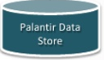

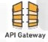










Data democratization
Driving adoption of foundry platform via custom applications and fully governed framework for data science on cloud
Access & User Interface
Ease of use
Exporting data from foundry to cloud for adhoc analysis ensuring governance and identify & access management
UI
IAM
Cognito
API
Gateway
Foundry
S3 Bucket
Analytics
Catalog & Search
Processing & Analytics
Custom applications for catalog & search, reporting & visualization and new feature development
Dynamo
DB
Glue
Catalog
Elastic
Search
Athena
EMR
Redshift
Data science
Framework for modeling using technologies like DataRobot, H2O etc.
Notes:
Enabling data as a service for quick analysis. Foundry has limited visualizations and users would prefer to download in local machines and upload in RDBMS for further analysis.
This can be enabled in AWS with custom build apps

Slide 12
A leading multinational company in cosmetics industry
Spot trends for Competitive Advantage
Identify beauty trends ahead of time
90 Million Conversations
ANN’s
Image Classification, spam removal and sentiment analysis
Revlon
Brands
Win in the Marketplace
Protect & Enhance Brand Value
Understand customer perceptions and purchase intent to help retain customers
against smaller competitors
Understand customer perceptions and purchase intent to help retain customers
against smaller competitors
Benchmark brand reach, engagement and evaluate campaign effectiveness
ML
Trend prediction
Demo

Slide 13




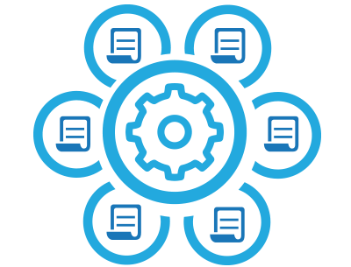
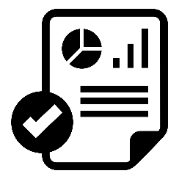
A leading multinational company in food industry
Prototype & Productionize Product Recommendation Engine At Scale
Enable new metrics development – Order line level logistics attribution
API for Data Products – Deal Broker Application, Recommendation Results
Operational Reporting by field sales managers (Highly concurrent request pattern)
Demo

Slide 14
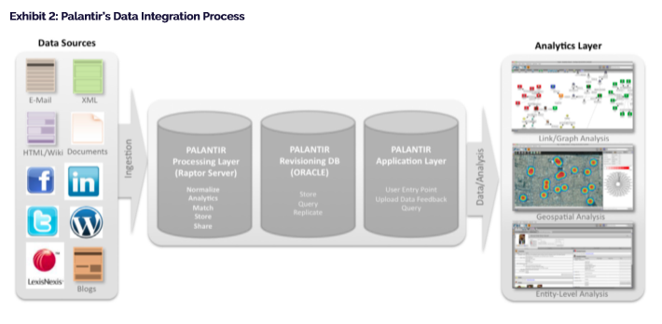
Palantir Framework for Analytics

Slide 15
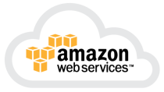

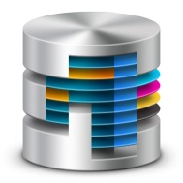




Data Science Framework
Data
Pre-Processing
Modelling
using Datarobot
& H2O
Getting the
results / output
Rolling Back the results to the system
Users
User login
User Activity Log
AWS Platform
Exporting Data from Palantir
Output Data sent to Palantir
UA Data Sources
Data can be exported in formats like XML, HTML , Excel / csv
Palantir Foundry

Slide 16
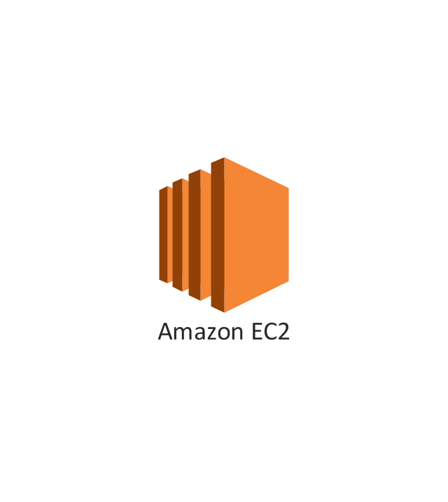

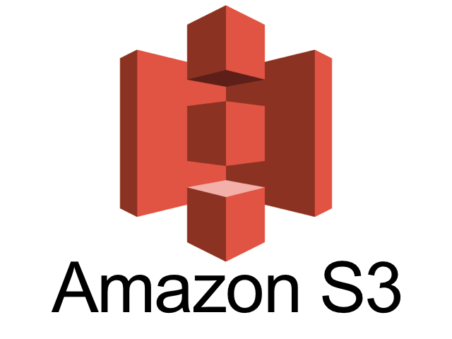

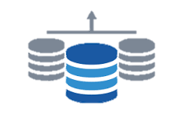




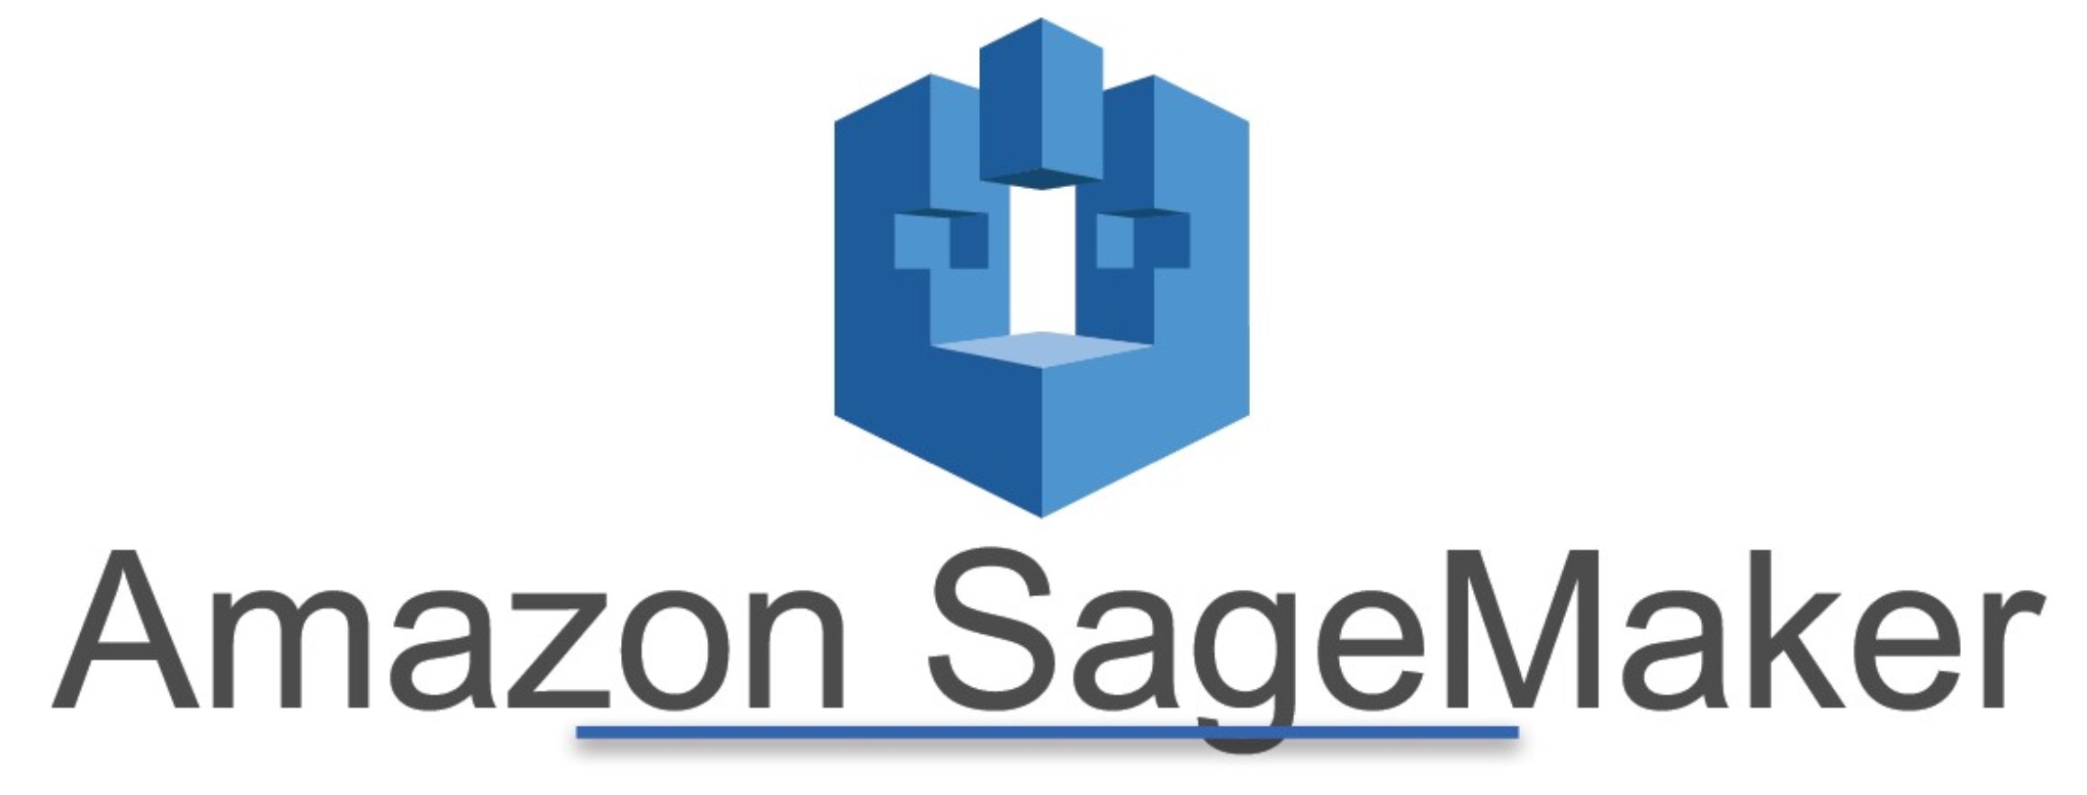
Our Understanding
Production Deployment on AWS or ingest into foundry
Run Predictions to generate Output (Versioned)
Train Data
Test Data
Validation Data
Integrating Solutions
Data Dictionary & Lineage UI
Custom Provision Environment
Code & Libraries
Documentation
AWS Glue Catalog
S3 + Custom Workspace for each user/project
Ingest from Foundry
Ad Hoc Upload / Process Upload / Ingest from File locations / FTP

Slide 17
Thank You
ganesh.sankaran@latentview.com

Slide 18
Appendix

Slide 19
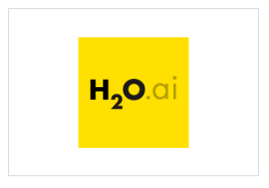
AWS Machine Learning Partner Solutions
APN Partners enabling data scientists and machine learning practitioners with tools to take their data, train predictive models and make predictions on new data
DataRobot
DataRobot for AWS offers an enterprise machine learning platform that empowers users of all skill levels to make better predictions faster. Companies of all sizes can deploy and scale DataRobot Cloud on AWS or on their Amazon VPC.
DataRobot captures the knowledge, experience and best practices of the world's leading data scientists, delivering unmatched levels of automation and ease-of-use for machine learning initiatives. DataRobot enables users to build and deploy highly accurate ML models in a fraction of the time.
H2O.ai
H2O is a fully Distributed In-Memory Machine Learning platform that supports the following algorithms: GLM, Distributed Random Forest, Gradient Boosting Machine, Deep learning, K-means , PCA, and more. It is extremely easy to use from R, Python & H2O Flow.
H2O.ai is focused on bringing AI to businesses through software. We are one of the leading open source platforms that makes it easy to deploy ML and predictive analytics to solve complex problems.
https://aws.amazon.com/machine-learning/partner-solutions/
Notes:
https://aws.amazon.com/blogs/apn/integrating-with-amazon-sagemaker-using-built-in-algorithms-from-external-applications/

Slide 20
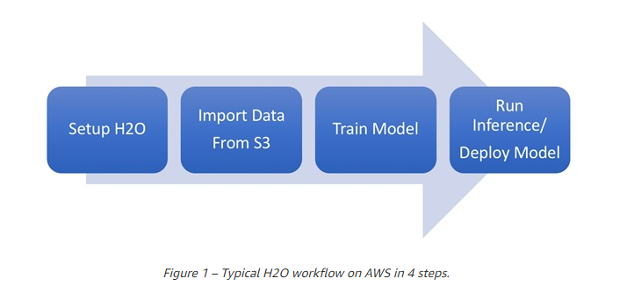
Deploying Machine Learning Models on AWS Using H2O
H2O is an open source data machine learning platform that provides a flexible, user-friendly tool to help data scientists and machine learning practitioners
To fully harness the power of H2O it should be deployed as a distributed application. This makes AWS the perfect choice for the deployment of H2O, which can be easily deployed directly from AWS Marketplace
https://aws.amazon.com/blogs/apn/4-steps-to-train-and-deploy-machine-learning-models-on-aws-using-h2o/

Slide 21
What LatentView Can Do ?
Data Understanding
Low
High
LatentView by virtue of having executed multiple engagements in the Consumer Insights space has a very good understanding of data elements which ensures a faster time to market & high quality analytics deliverables
Analytical Frameworks
Shallow
Comprehensive
LatentView has built comprehensive frameworks in the areas of Visualization, Social Analytics & Predictive Modelling which can be leveraged for all analytical initiatives across the globe
Chatbot Demo
Relationship Strength
Low
High
LatentView has been working with Revlon recently and has built good credibility with business stakeholders across business functions
Tableau Demo
Analytics Competency
One of many
services
Core Focus
LatentView is a boutique analytics service provider and so has people who are highly skilled in areas like Visualization, Text Mining, Predictive modelling
Notes:
Add: Demo links of one visually appealing tableau dashboards either from pepsi or mead Johnson : Pepsi : https://10az.online.tableau.com/t/latentviewanalyticscorporationdemo/views/PAID-AdvancedDiagnostics/SupplyChainHealth?iframeSizedToWindow=true&:embed=y&:showAppBanner=false&:display_count=no&:showVizHome=no
Add: Chatbot link for demo : http://ec2-52-200-210-195.compute-1.amazonaws.com:5000/

Slide 22
Illustrative Roadmap for Adoption of Analytics CoE
As analytics deployment transitions through these waves, the challenge is to sustain momentum and showcase value continuously
 | Initiate Success | Consolidation | Expansion
Objective | Small initiatives, quick wins | Deploy analytics solutions for usage by business. Reduce the no of reports | Democratize analytics solutions across enterprise
Scope | Focus on actionable pilot projects that have the support of the business and where success can be quickly measured | Focus on multiple large analytics solution deployments across different divisions | Focus on automated decisioning, self-serve solutions, machine learning
Industry Status | Many firms have completed or in the process of completing this wave | Analytics savvy firms are pulling ahead. Some of the traditional firms are in early stages | ‘Analytics as Foundation’ firms like CapitalOne, Google are in this stage. Some of the traditional firms have built it in pockets

Slide 23


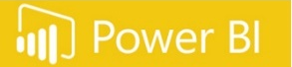

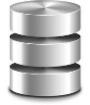
Maturity of BI CoE model
Stage 5
Technological advancements like chatbot
Stage 4
Reporting via BI tools like Tableau / Power BI / DOMO
Reporting via BI tools like Tableau / Power BI / DOMO
Stage 3
BI CoE Model
Data engineering, accumulation of data at one place
Data engineering, accumulation of data at one place
Data engineering, accumulation of data at one place
Stage 2
Identifying and Monitoring the consumption
Identifying and Monitoring the consumption
Identifying and Monitoring the consumption
Identifying and Monitoring the consumption
Stage 1
Understanding & Analyzing
Understanding & Analyzing
Understanding & Analyzing
Understanding & Analyzing
Understanding & Analyzing
Analysis Maturity
Notes:
Curve showing how BI CoE grows
Step1: Understanding and analyzing the needs of various BU’s
Step2: Identifying and Monitoring the consumption of various reports by BU’s
Step3: Data engineering, accumulation of data at one place for ease of use and efficient data analysis
Step4: Reporting via BI tools like tableau, power BI, Domo etc.
Step5: Technological advancements like chatbot
Abhineet has created a similar slide in the past for Mead Johnson

Slide 24
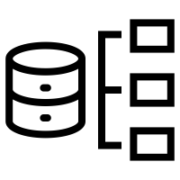

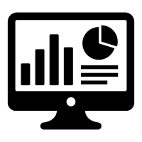

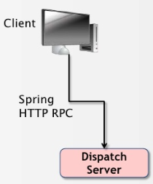

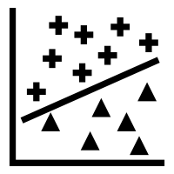










Overview & Where LatentView Can Help
Palantir
Custom Application
Analytics
Client Connection API provides the link for Searching and Extraction of Entity Objects
Unstructured or Structured Data Collaboration and Storage API’s from different sources
Hercules API
Automated Analysis
Anomaly Detection
Behavioral Pattern Recognition
Ranked Clustering
Programmatically Query, Modify, Export Information into the application
Processing, Data Management and Transformation into Palantir Data Store (ETL) as Objects
Application - Blueprint, Django & REST
Visualizations and Reporting – Plottable , D3 JS

Slide 25
Business Objective
Business Context
UA is planning for a Data Migration to Palatir Foundry and would like to develop reports and customized apps in that platform
Also, UA would like to design the framework for integrating technologies like Datarobot & H2O in Palatir Foundry environment
Objectives
LatentView proposes to build a centralized solution and framework encompassing the reporting , app development, modelling and adoption automated and consolidated visualization and reporting solution.
The work plan includes :
Automated and consolidated visualization for reporting solution
Designing Wireframes & Integration of technologies like Datarobot & H2O in Palatir Foundry
Framework for adoption

Slide 26
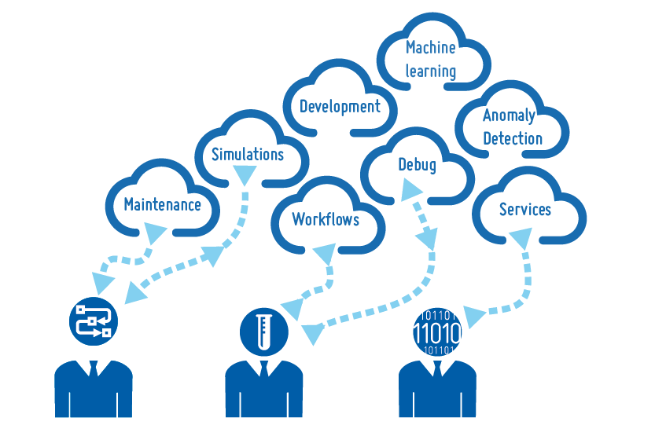


Our Understanding
United Airlines is migrating to Palantir Foundry platform for Data Integration & CoE
Data migration
Monitoring & Maintenance
Data democratization
Custom build UI/apps for reporting & insight generation
New features development enabling data pull for adhoc analysis in a governed environment
Data science framework and integration with current technologies like DataRobot
Moving data from existing data sources to foundry
Creating data pipeline for future updates
ETL management
Integration of new data sources
Access management & decentralization of data platform

Slide 27

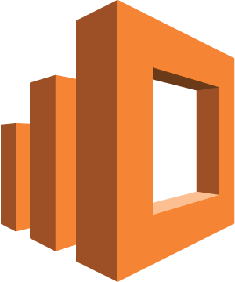


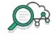


Reporting & visualization framework
Users query API to export data from foundry to S3 and use AWS framework for data analysis & visualization
Foundry
User
UI
API
Gateway
Serverless
Lambda
EMR
Elastic
Search
S3
Bucket
Access & User Interface
Provide easy & secure access
Protect and Secure
Use entitlements to ensure data is secure and users’ identities are verified
API Gateway
Lambda
IAM
Cognito
Identity & Access
Management
Security Token
Service
CloudWatch
CloudTrail
Key Management
Service
Notes:
Enabling data as a service for quick analysis. Foundry has limited visualizations and users would prefer to download in local machines and upload in RDBMS for further analysis.
This can be enabled in AWS with custom build apps

